Slide 1
KestrelSAT
Intro & Initial Assembly

Slide 2
Intro
KestrelSAT is…
Intro
Reference
Task 1
Task 2
Turn-in Reqt’s
TBD
Authorized Resources
This is a team effort lab
External resources should not be necessary, but you may use:
Any non-human resource
Generative AI Level 4 Allowed
Astro 331 course instructor
Objectives:
Understand KestrelSAT…
Conduct initial assembly of KrestrelSAT

Slide 3
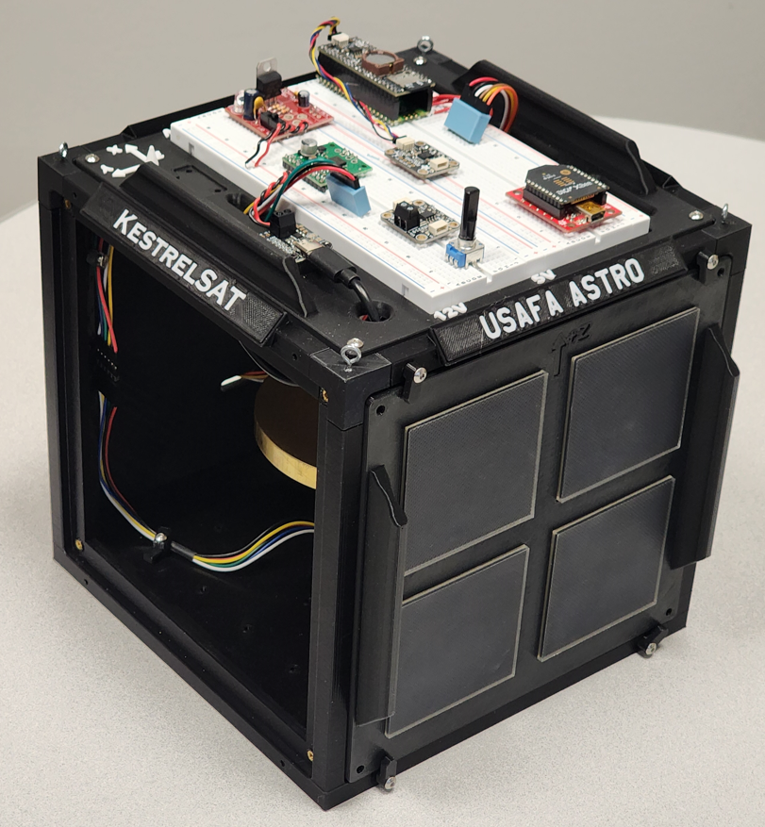
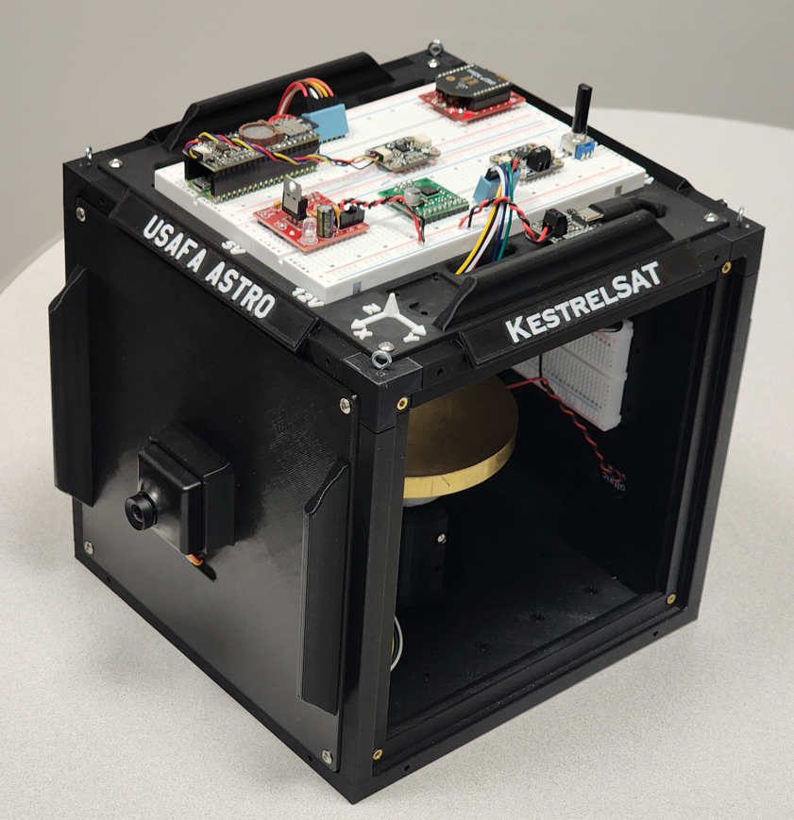
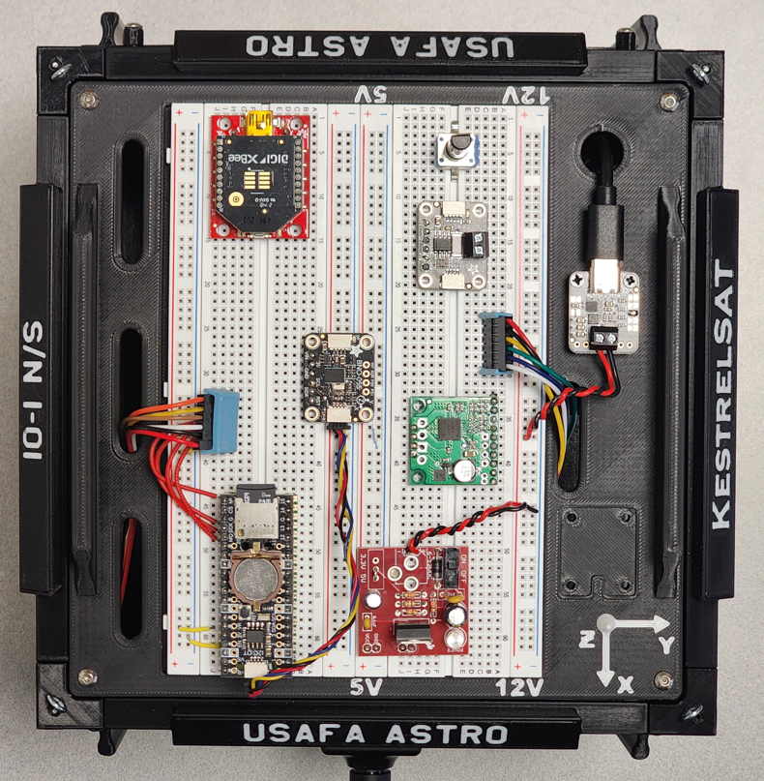
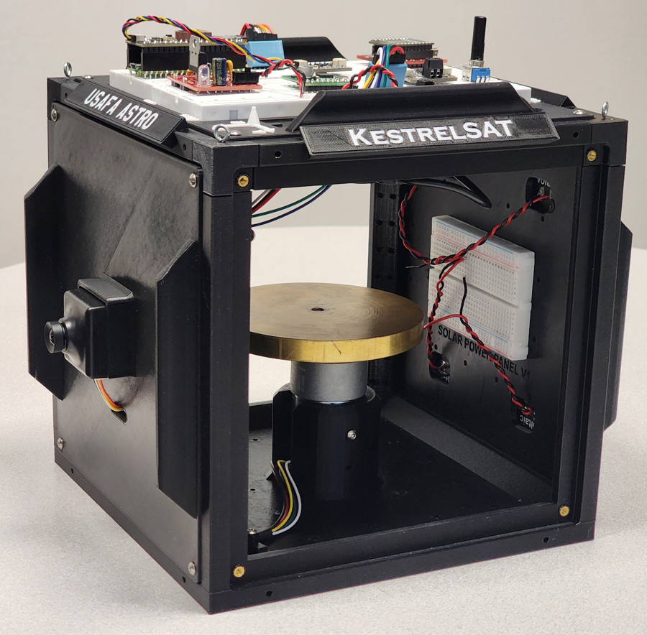
KestrelSAT Overview
Intro
Reference
Prelab
Task 0
Task 1
Task 2
Task 3
Turn-in Reqt’s
Solar Power Side
Reaction Wheel
Camera Side
Solar Power
V & I Sensor
Comm (Xbee transceiver)
Battery Controller
IMU (BNO055)
Motor Driver
MCU (Rpi Pico)
Memory (SD)
Real-Time Clock
12V DC to 5V DC Regulator

Slide 4
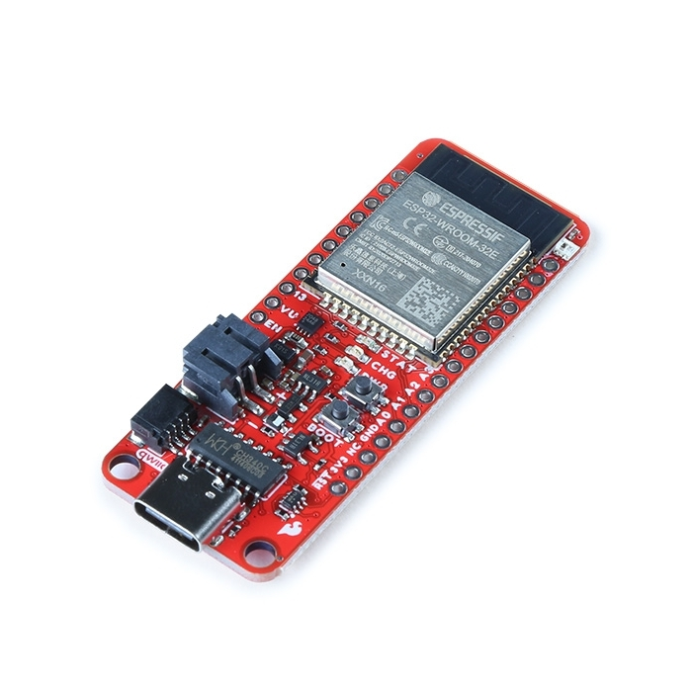
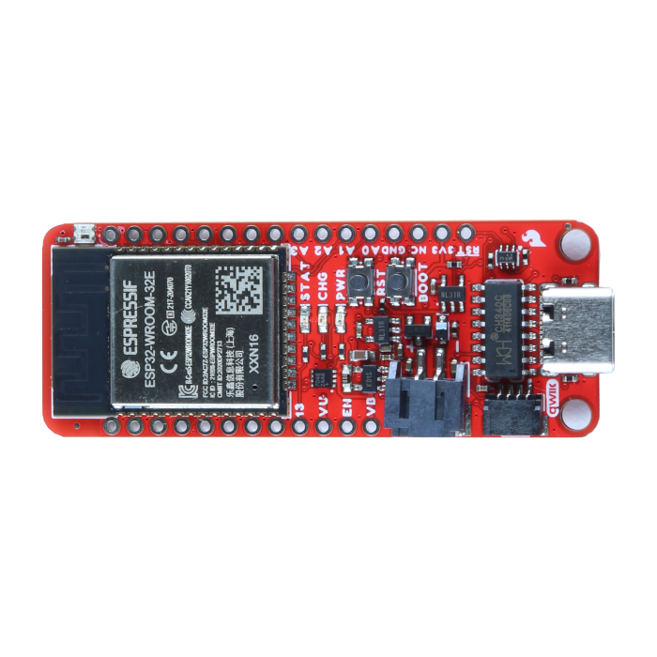
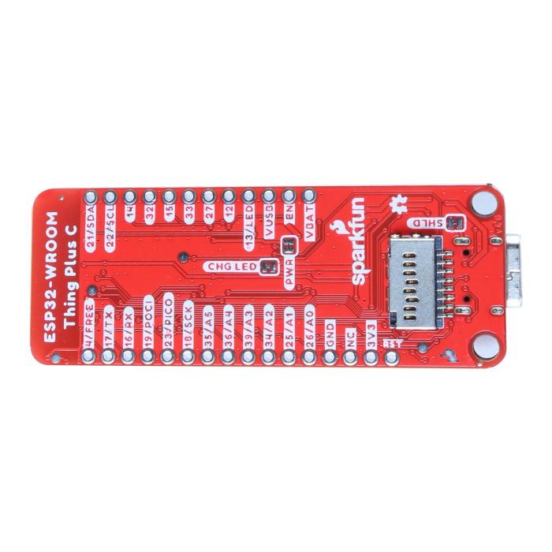
KestrelSAT MCU: ESP32 WROOM
KestrelSAT uses an Espressif ESP32 WROOM MCU on a Sparkfun Thing Plus breakout board.
Features:
Xtensa® Dual-Core 32-bit LX6 Microprocessor (up to 240MHz)
448KB of ROM and 520KB SRAM, 16MB of Embedded SPI flash storage
21 Multifunctional GPIO, Up to thirteen 12-bit ADC Channels
Up to sixteen PWM outputs, Up to two DAC channels
Integrated 802.11b/g/n WiFi 2.4GHz transceiver
Integrated dual-mode Bluetooth® (classic and BLE®)
MAX17048 Fuel Gauge
Intro
Reference
Prelab
Task 0
Task 1
Task 2
Task 3
Turn-in Reqt’s
LEDs
PWR - Red power LED
CHG - Yellow battery charging indicator
STAT - Blue status LED (user-programable)
WS2812 RGB LED (user-programable)
Connectors
USB-C Connector
2-pin JST Connector for a LiPo Battery
4-pin JST Qwiic Connector
SD Card Slot
WARNING
This MCU is a 3.3V microcontroller. DO NOT apply >3.3V (i.e. 5V or 12V) to any pin on the device, except:
- 5V via the USB connecter (i.e. power from laptop or 5V charger)
- 5V to VUSB pin
- Up to 4.2V to VBAT pin
Product Page
Tutorial

Slide 5
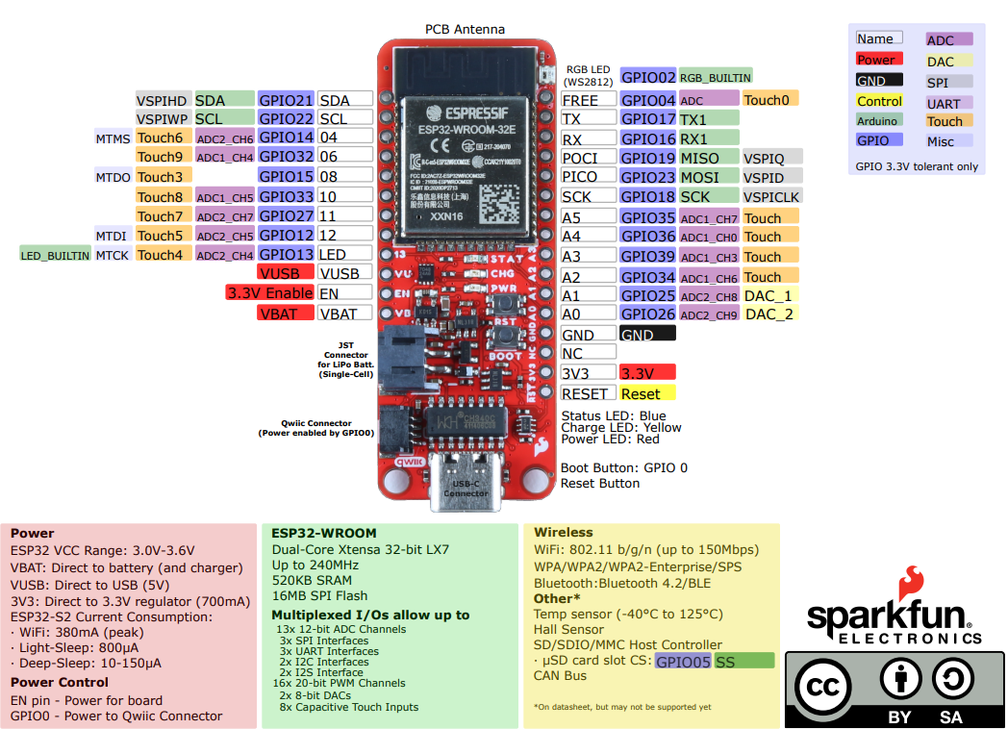
ESP32 Thing Plus Pinout Diagram
Intro
Reference
Prelab
Task 0
Task 1
Task 2
Task 3
Turn-in Reqt’s

Slide 6
EPS Diagram

Slide 7
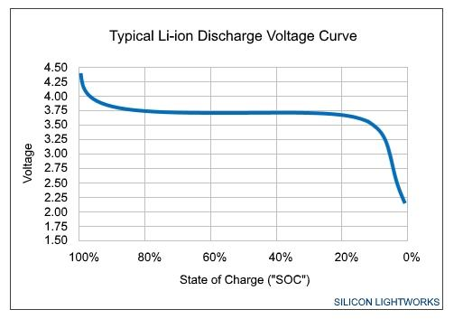
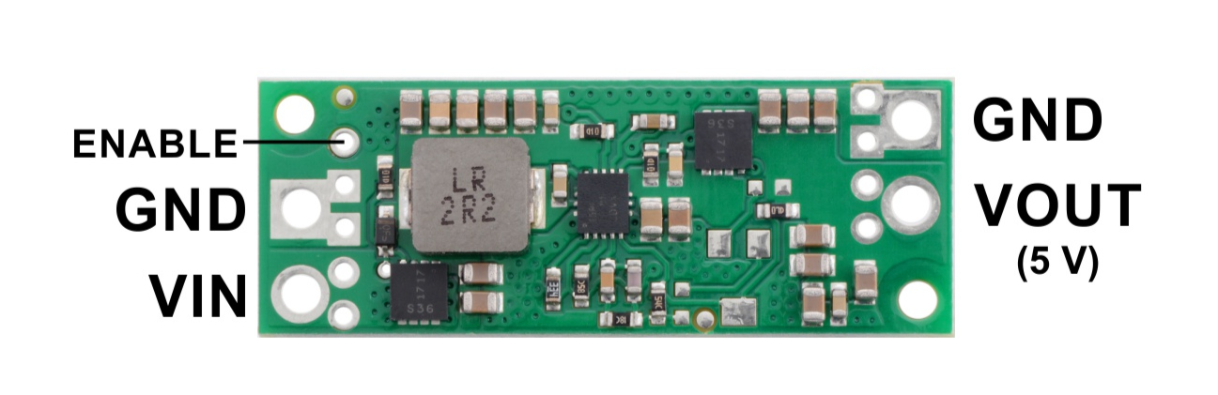
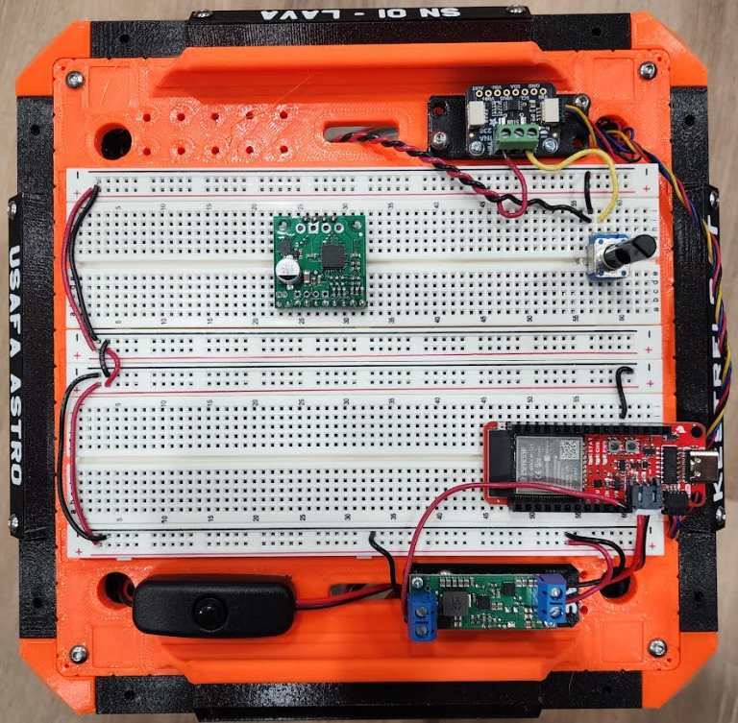
Task 3 – Finish Setting Up KestrelSAT EPS
In this task you will prepare for future labs by completing setup of the electrical power system for your KestrelSAT.
Using a multimeter, measure the voltage of your KestrelSAT battery. Discuss with your instructor how to estimate the state of charge of the battery.
Install the battery and connect it to the female end of the power switch. Connect the male end of the power switch to the battery connector on your MCU. Confirm you can power on your KestrelSAT with the power switch.
Link all power rails on your breadboard together using red and black jumper wires (red for + and black for -).
Connect a black wire from MCU ground pin to the ground rail.
Connect the VBAT to the VIN terminal of the 5V Step-Up Regulator. Connect a black or brown wire from the ground rail to ground of the regulator.
With KestrelSAT powered on, confirm the regulator provides 5V on the VOUT pin. Connect VOUT to the + power rail. All power rails on the breadboard are now 5V potential.
Intro
Reference
Prelab
Task 0
Task 1
Task 2
Task 3
Turn-in Reqt’s
5V Step-Up Voltage Regulator U3V70F5
(3)
(4)
(5)
(2)

